Slide 1
Artificial Intelligence and Machine Learning
Gururajan Narasimhan

Slide 2
Brief outline – Gururajan Narasimhan
20+ years of experience in software development and training after Masters Degree in Engineering (Applied Electronics, CIT, Coimbatore, 1995)
Worked in multiple roles as senior software engineer, tech lead and architect , currently a senior consultant doing training and development across Wipro Technologies in Artificial Intelligence, Machine Learning, Data Science domains and Programming in Python and C++

Slide 3
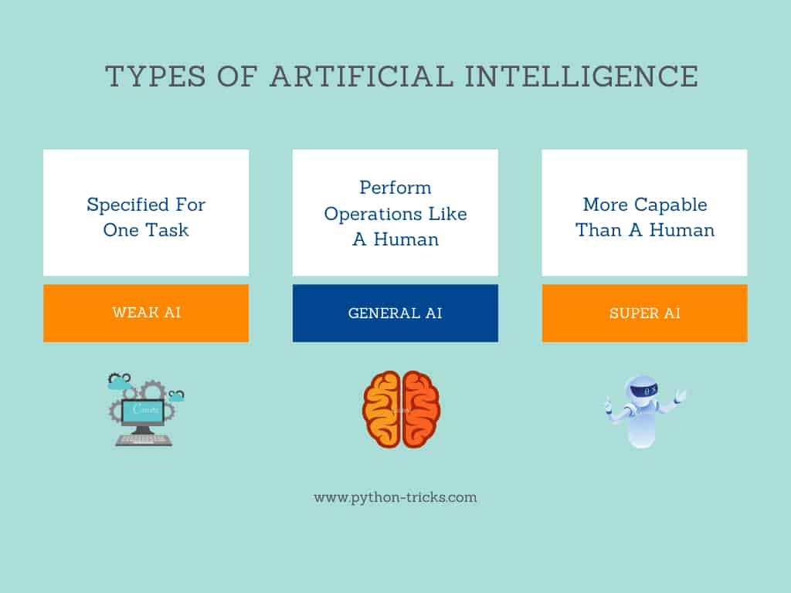
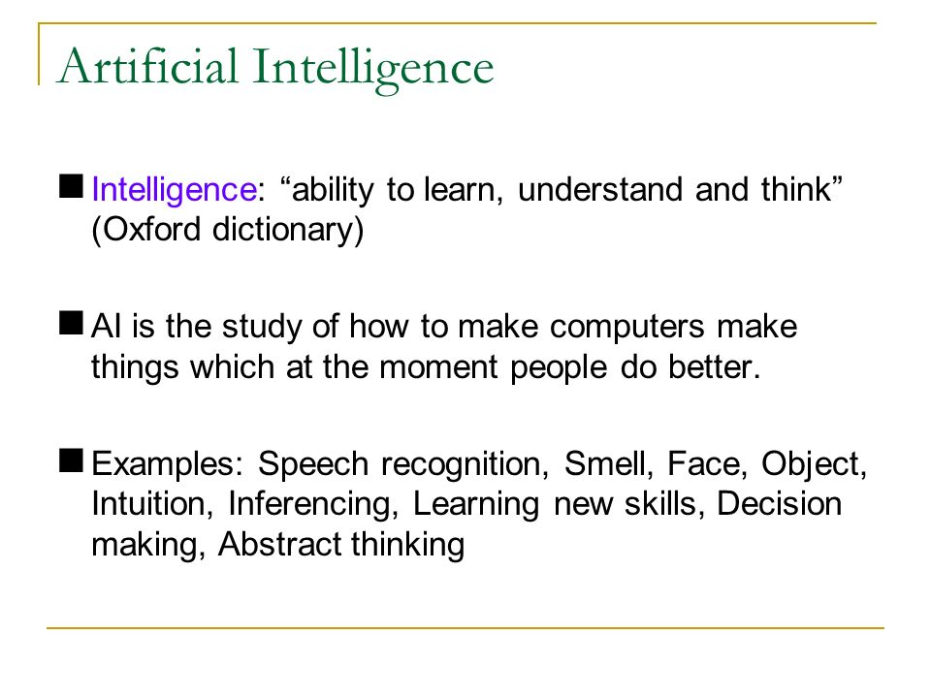

Slide 4
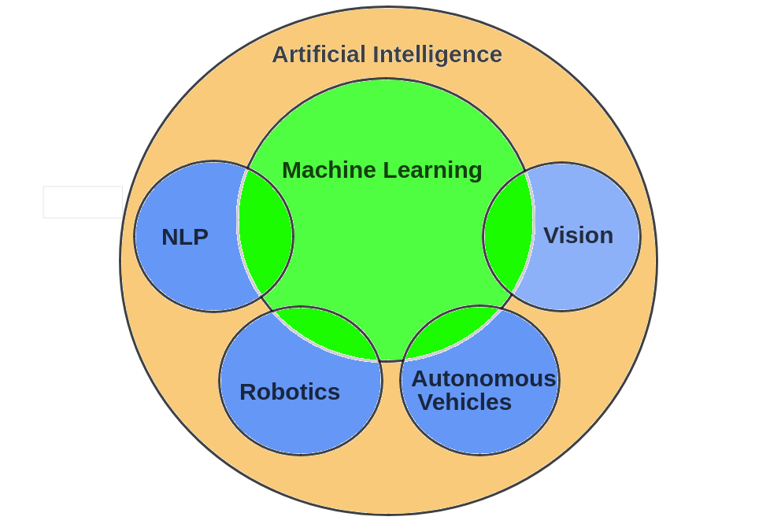

Slide 5
Artificial Intelligence
Humans
Computers
We see
We speak and we listen to other people speak
We read from a given text, understand and write text
We smell
We touch, move and run
We think, reason, make decisions in real time based on current inputs and experience, learn, extract useful information from data, perform cognitive functions such as problem solving,
We feel
Computer Vision
Speech recognition / voice recognition
Natural Language Processing (NLP)
Nothing still, may be possible
Kinematics and robotics
General AI – just starting
Nothing still, is it really possible?

Slide 6
Artificial Intelligence – General Intelligence – Strong AI – Broad AI
Machines that mimic the cognitive functions that humans associate with other human minds, such as “complete learning” and “problem solving”.
This is Strong AI or Full AI
General AI or Full AI is the complete cognitive abilities and decision making sensory range of properties that human’s have.
Nobody in the world has successfully make products in General AI, the likes of – think Arnold Schwarzenegger in terminator or Chitti in Robot 1

Slide 7
Artificial Intelligence - Examples of Applied AI – Weak AI – Narrow AI
Domain specific chat bots like the Wipro's helpline or in general any immigration help system
Amazon’s recommendation Engine
deep blue the first computer based chess playing champion
The Advanced Driver Assistance Systems (ADAS)

Slide 8
Artificial Intelligence - Examples of Applied AI – Weak AI – Narrow AI
Amazon’s “echo dot” and “echo plus” voice recognition systems
NEST home connectivity startup acquired by google in 2014
Pandora Internet Radio is a music streaming service and automated music recommendation service powered by the Music Genome Project
Deep mind of google is now in Applied AI, but they want to keep their mind on General AI as well https://deepmind.com/about/

Slide 9
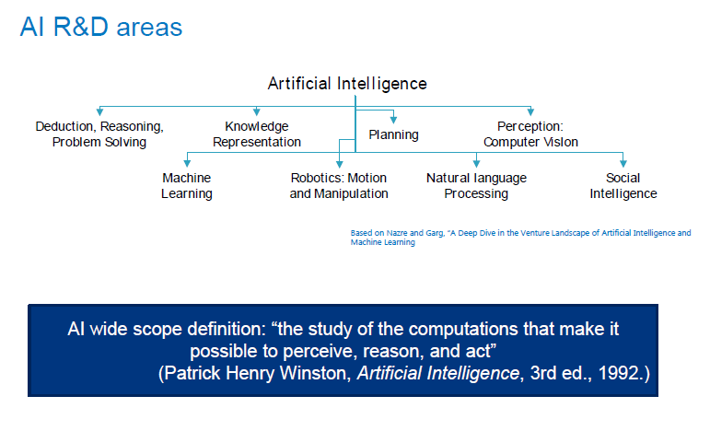

Slide 10
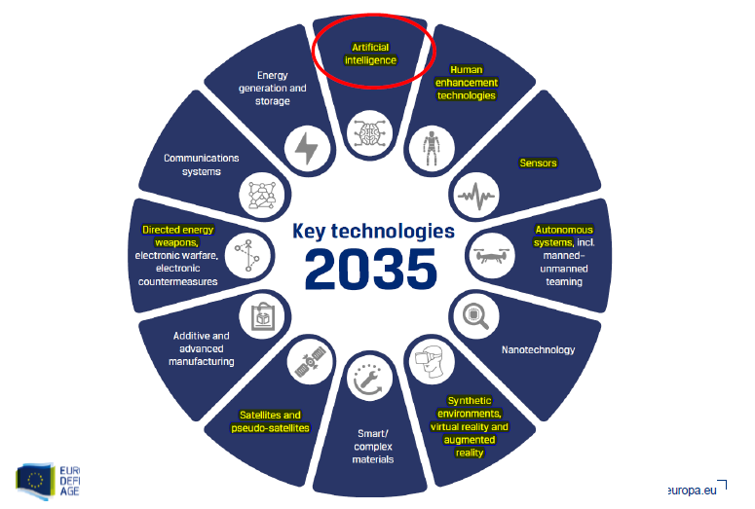

Slide 11
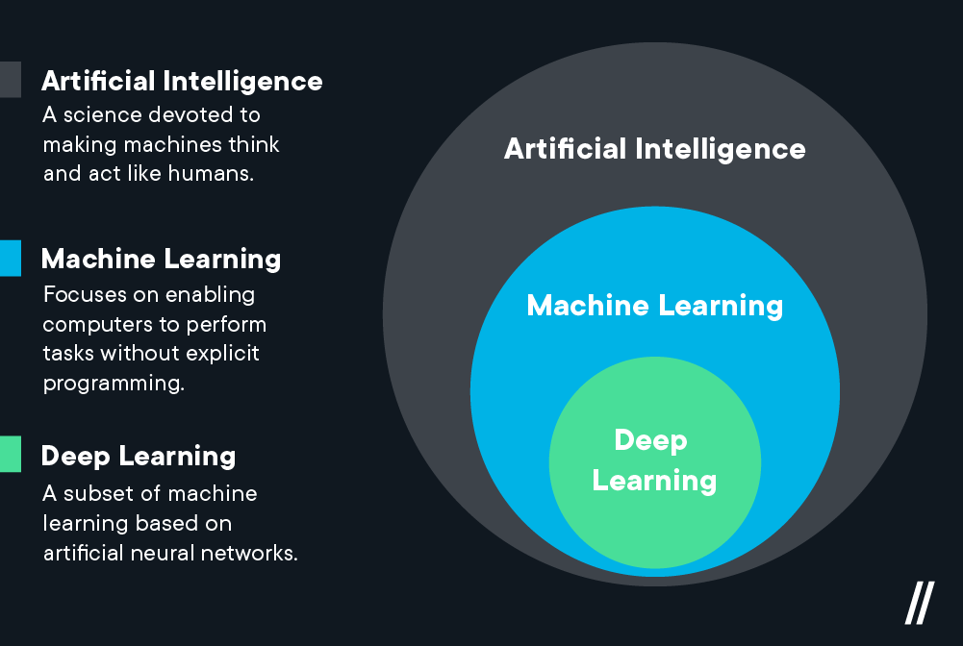

Slide 12
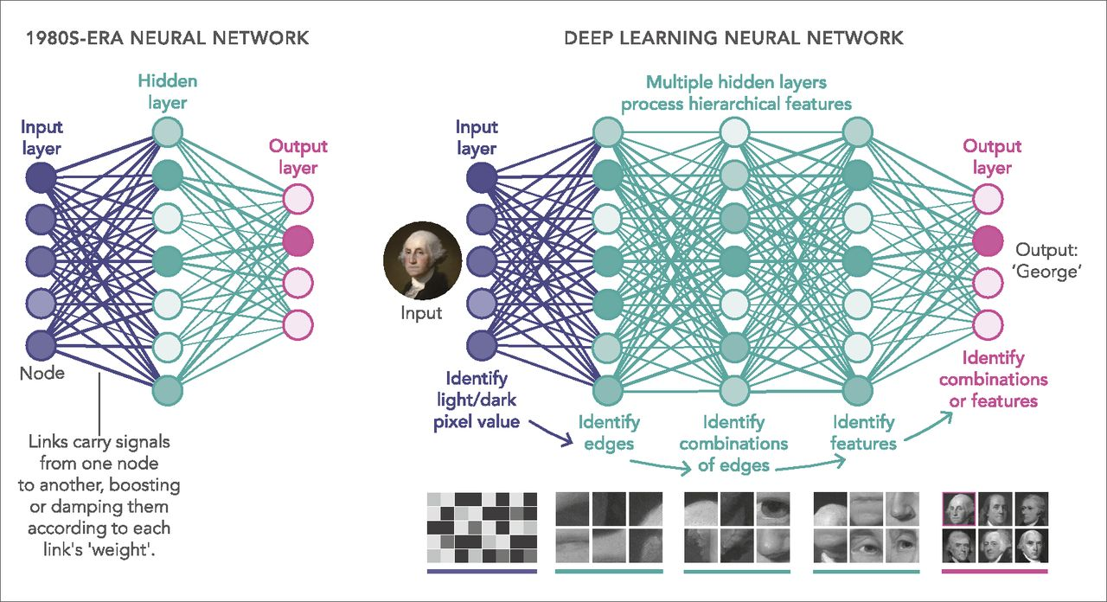

Slide 13
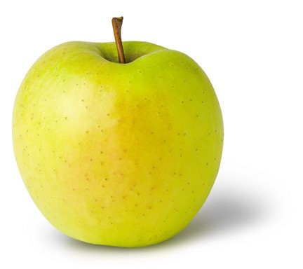
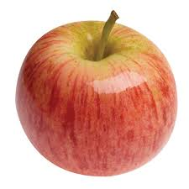

Learning (Training)
y = f(x)
output
prediction function
Image feature
Features:
1. Color: Radish/Red
2. Type : Fruit
3. Texture : Soft
4. Shape
etc…
Features:
1. Sky Blue
2. Logo:
3. Texture :
4.Shape
etc…
Features:
1. Yellow
2. Fruit
3. Texture : Soft
4.Shape
etc…
What do you mean by Apple?

Slide 14
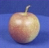
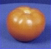
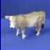
The machine learning framework
Apply a prediction function to a feature representation of the image to get the desired output:
f( ) = “ apple”
f( ) = “ tomato”
f( ) = “ cow”
Training: given a training set of labeled examples {(x₁,y₁), …, (x_{N},y_{N})}, estimate the prediction function f by minimizing the prediction error on the training set
Testing: apply f to a never before seen test example x and output the predicted value y = f(x)
Slide credit: L. Lazebnik

Slide 15
What is what in ML
In machine learning the pictures or words or actual numbers are the – DATA – this is ‘x’ the input variable
The names you gave for those pictures – LABELS or OUTPUT -- labeled output
Program writing in Python, R or C++ -- LEARNING ALGORITHM -- this is the program you write in python
The equations which you have built – the model of an apple you have in mind - MODEL – The model is also the function “ f “
Then when a real apple is then shown to you, then you say it is an apple, this is the PREDICTED OUTPUT – ‘ y’

Slide 16
Machine Learning - Terminology
Features
The number of features or distinct traits that can be used to describe each item in a quantitative manner
Samples
A sample is an item to process (e.g. classify). It can be a document, a picture, a sound, a video, a row in database or CSV file, or whatever you can describe with a fixed set of quantitative traits.
Feature vector
is an n-dimensional vector of numerical features that represent some object.
Feature extraction
Preparation of feature vector
transforms the data in the high-dimensional space to a space of fewer dimensions.
Training/Evolution set
Set of data to discover potentially predictive relationships.

Slide 17
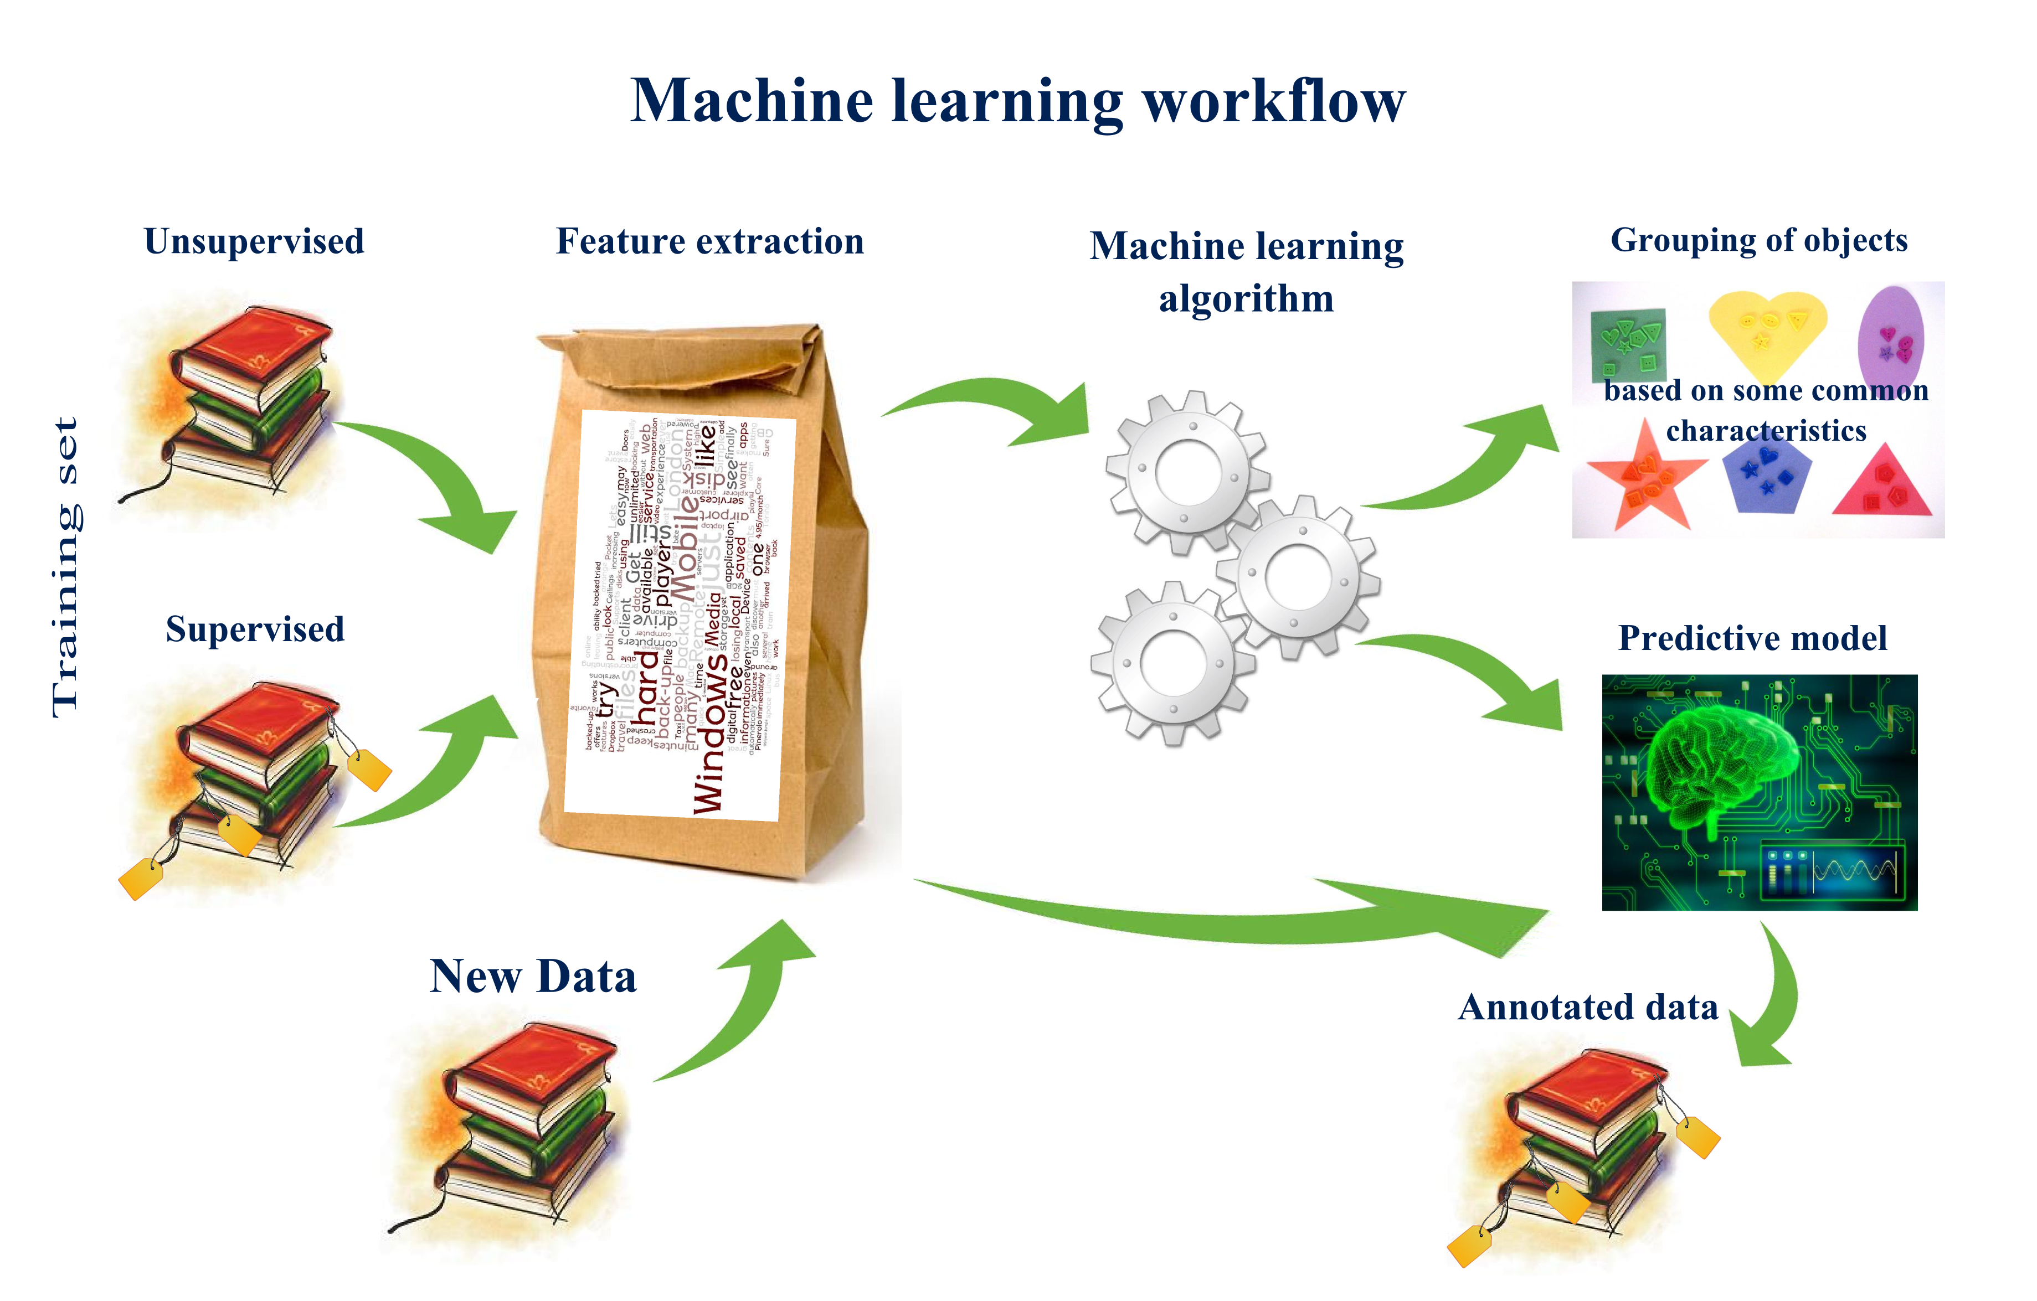

Slide 18
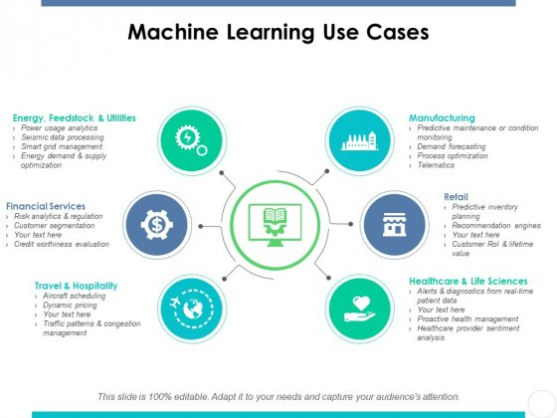

Slide 19
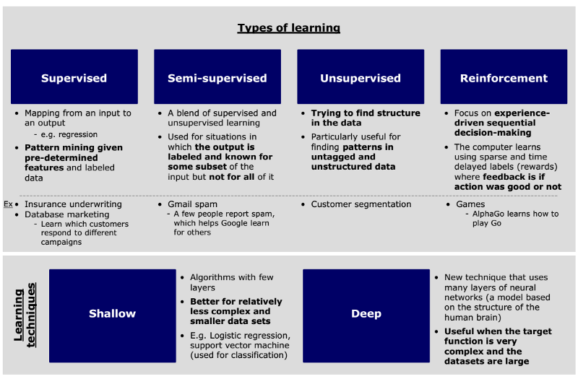
http://sungsoo.github.io/2017/03/28/three-things-you-need-to-know-about-machine-learning.html

Slide 20
Supervised Learning
Supervised learning is the machine learning task of inferring a function from labeled training data. The training data consist of a set of training examples.
In supervised learning, each example is a pair consisting of an input object (typically a vector) and a desired output value (also called the supervisory signal)
Unsupervised learning is a type of machine learning algorithm used to draw inferences from datasets consisting of input data without labeled responses.
The most common unsupervised learning method is cluster analysis, which is used for exploratory data analysis to find hidden patterns or grouping in data.

Slide 21
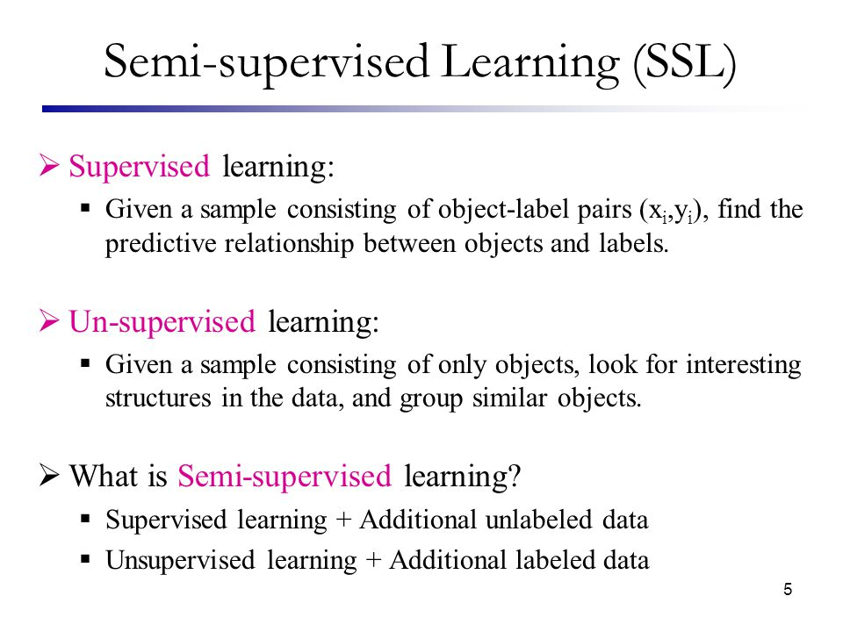

Slide 22
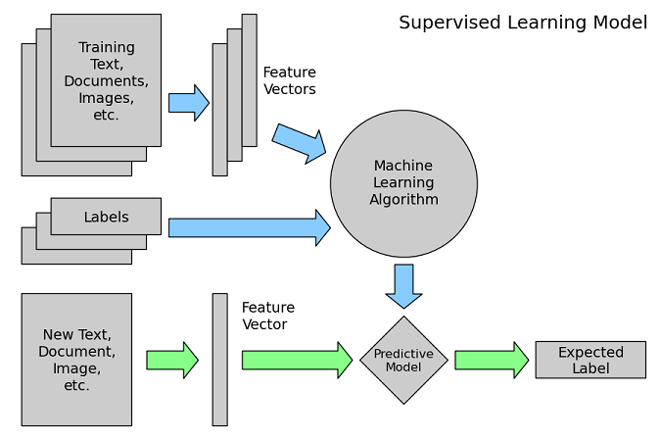

Slide 23
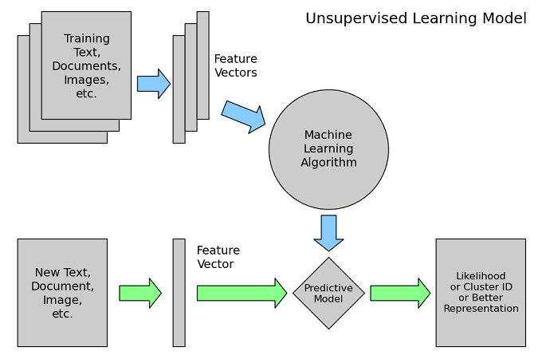

Slide 24
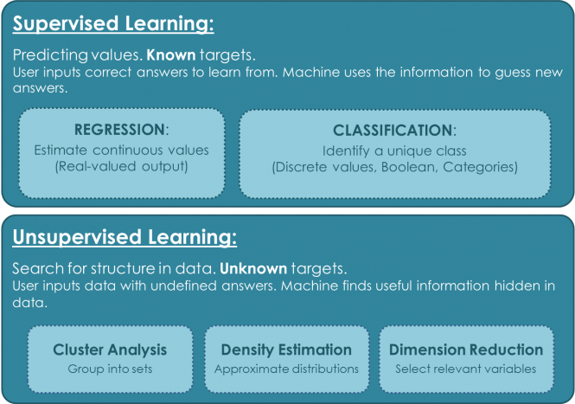

Slide 25
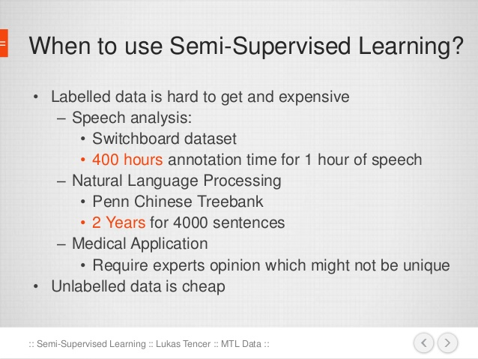

Slide 26
Reinforcement Learning
Reinforcement learning, in the context of artificial intelligence, is a type of dynamic programming that trains algorithms using a system of reward and punishment.
A reinforcement learning algorithm, or agent, learns by interacting with its environment. The agent receives rewards by performing correctly and penalties for performing incorrectly. The agent learns without intervention from a human by maximizing its reward and minimizing its penalty.

Slide 27
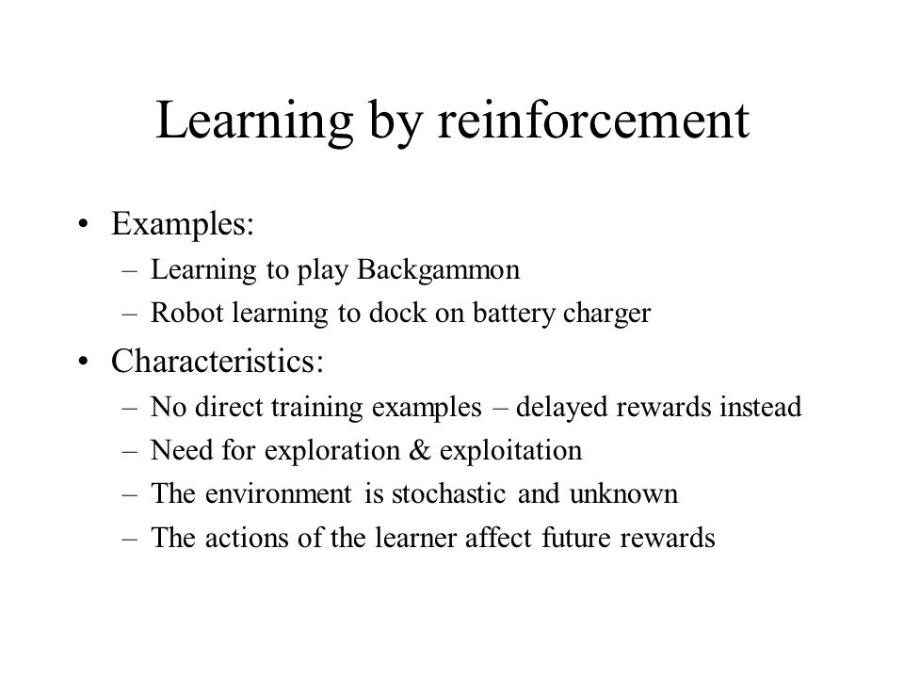

Slide 28
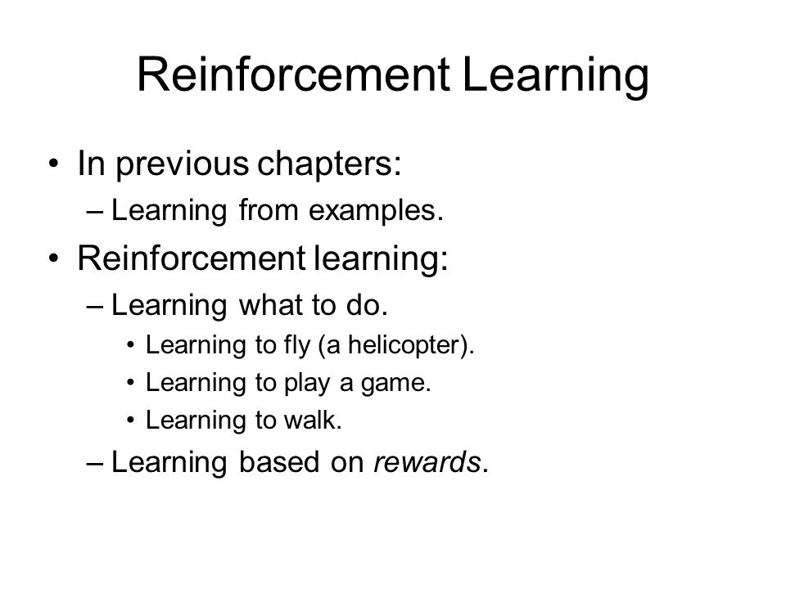

Slide 29
Machine Learning Techniques – a comparison with humans
What humans do | Name of that technique in Machine Learning
Predict the class of data | Classification or Categorization
Predict a numerical value, continuously varying value | Regression
Group items or products or customers to different meaningful groups | Clustering
Show similar items or products | Recommendation
Associate a new item with already selected items | Association Rule Mining
Analyze and extract knowledge from chronological data | Time Series Analysis
Choose the most important features | Dimensionality Reduction

Slide 30
Machine Learning Techniques – a comparison with humans
What humans do | What is the that technique in Machine Learning
Fit an appropriate distribution for the given data to gather density and peak information | Density estimation
Combine many methods to get a best result | Ensemble learning
Find the odd man out in the given data | Outlier detection or Novelty detection or Anomaly detection
Simulate the way the brain works and find a solution to a problem | Neural networks and deep learning
Top 10 movies, Top 10 songs, Top 10 stocks to pick, Top 10 colleges to study | Ranking
Learn from criticism and praise | Reinforcement Learning
Understand how the genes retain and keep information and improvise | Genetic Algorithms

